Slide 1
The Battle of The Neighbourhoods
BY Mulaedza Mathoho

Slide 2
Introduction
Background: A factor such as Safety has an impact on people migration. Safety becomes a concern when people decide to migrate to another location.
Problem:The crime statistics dataset of London found on Kaggle has Crime in major metropolitan areas, such as London, occurs in distinct patterns. The year 2016 being the latest we will be considering the data of that year which is actually old information as of now. The crime rates in each borough may have changed over time.
Interest: People who are willing to migrate to London need to know about their safety. Also it is important to explore its neighbourhoods and common venues around each neighbourhood.

Slide 3
Data Acquisation and Cleaning
Data Aqcuisation:
In this project a number of datasets were used. This is the list of the 3 datasets that were used for the project:
London crime data : : https://www.kaggle.com/jboysen/london-crime
list of London boroughs : https://en.wikipedia.org/wiki/List_of_London_boroughs
list of Neighbourhoods in the Royal Borough of Kingston upon Thames :

Slide 4
Data Cleaning : Data cleaning for each of the three data sets was done separately.
Considering the London crime data, only crimes during the most recent year were selected (2016).
Using the Beautiful Soup library, the second data (list of London boroughs) was scraped from Wikipedia. Using this library we can extract the data in the tabular format as shown in the website.
String manipulation was also done to get the names of the boroughs in the correct format.
After visualizing the crime in each borough we can find the borough with the lowest crime rate and hence tag that borough as the safest borough.
The third source of data is acquired from the list of neighbourhoods in the safest borough on wikipedia. This dataset is created from scratch, the pandas data frame is created with the names of the neighbourhoods and the name of the borough with the latitude and longitude left blank.

Slide 5
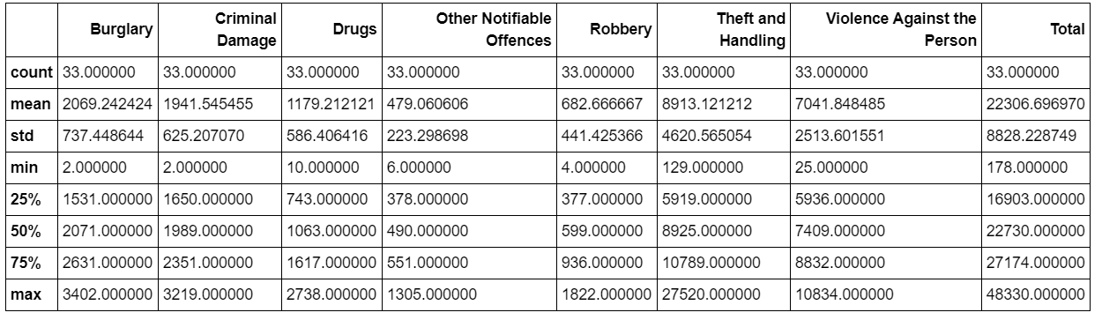
Methodology
Exploratory Data Analysis : Summary Statistic
London Crime statistical summary showing the Count,Mean,Standard deviation,minimum,nmaximum,1st Quartile, 2nd Quartile and 3rd Quartile

Slide 6
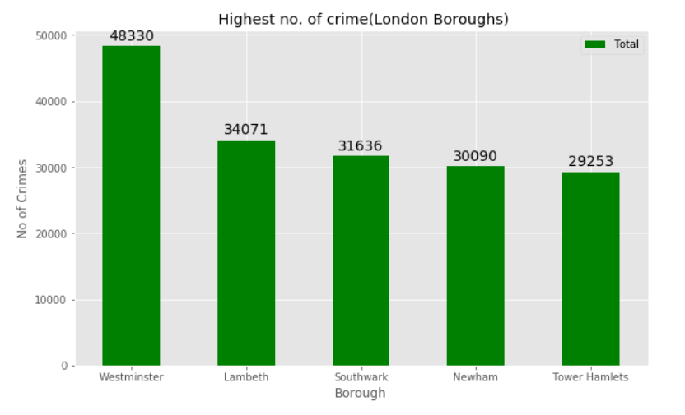
The top 5 boroughs with the highest crime rate. We will stay away from this place.

Slide 7
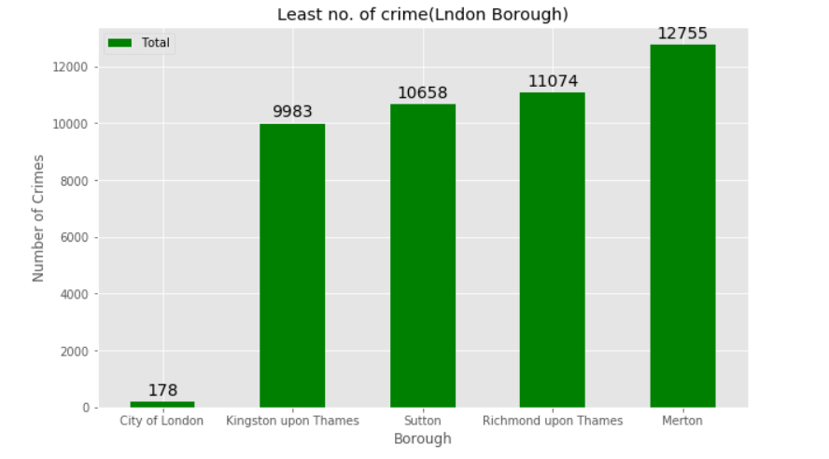
The top 5 boroughs with the lowest crime rate

Slide 8
Looking at the graphs, As per the wikipedia page, The City of London is the 33rd principal division of Greater London but it is not a London borough. Hence we will focus on the next borough with the least crime i.e. Kingston upon Thames.
We will consider the next borough with the lowest crime rate as the safest borough in London which is Kingston upon Thames.

Slide 9
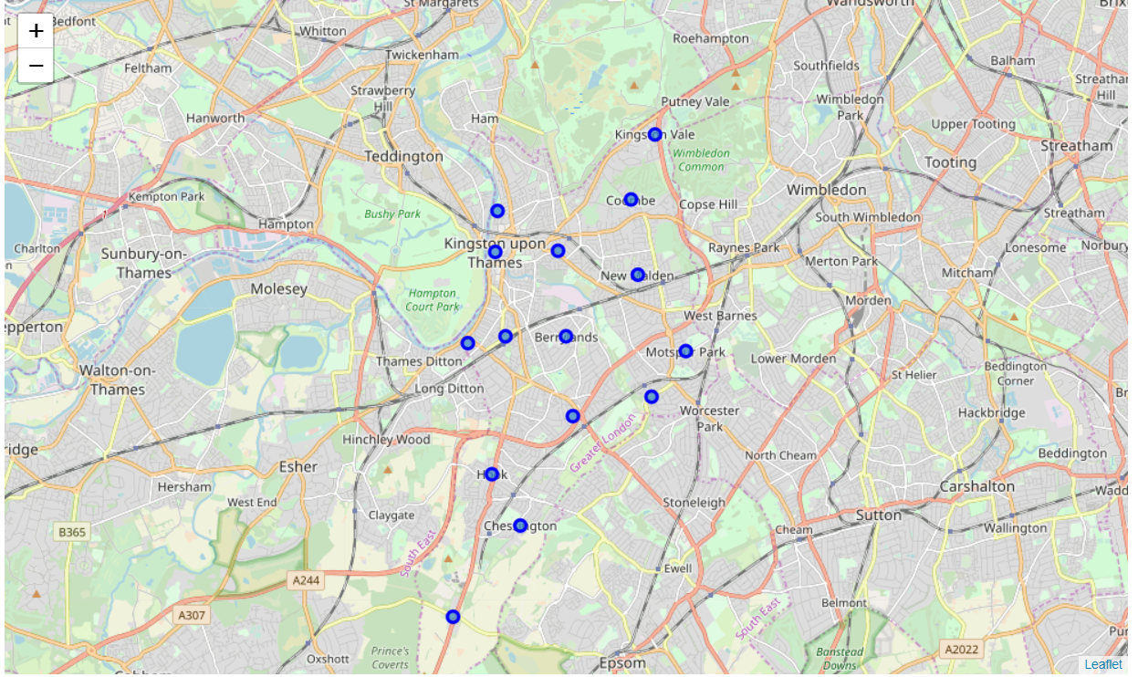
Neighbourhoods in Kingston upon Thames
Kinston Upon Thames contains 15 neighbourhoods , this were visualised on a map using folium on python.

Slide 10
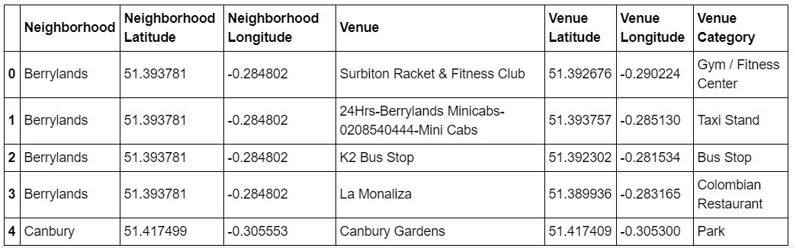
Modelling :
Using the final dataset containing the neighbourhoods in Kingston upon Thames, this were the goals achieved:
Finding all the venues within a 500-meter radius of each neighbourhood.
Perform one hot encoding on the venues data.
Grouping the venues by the neighbourhood and calculating their mean.
Performing a K-means clustering (Defining K = 5)

Slide 11
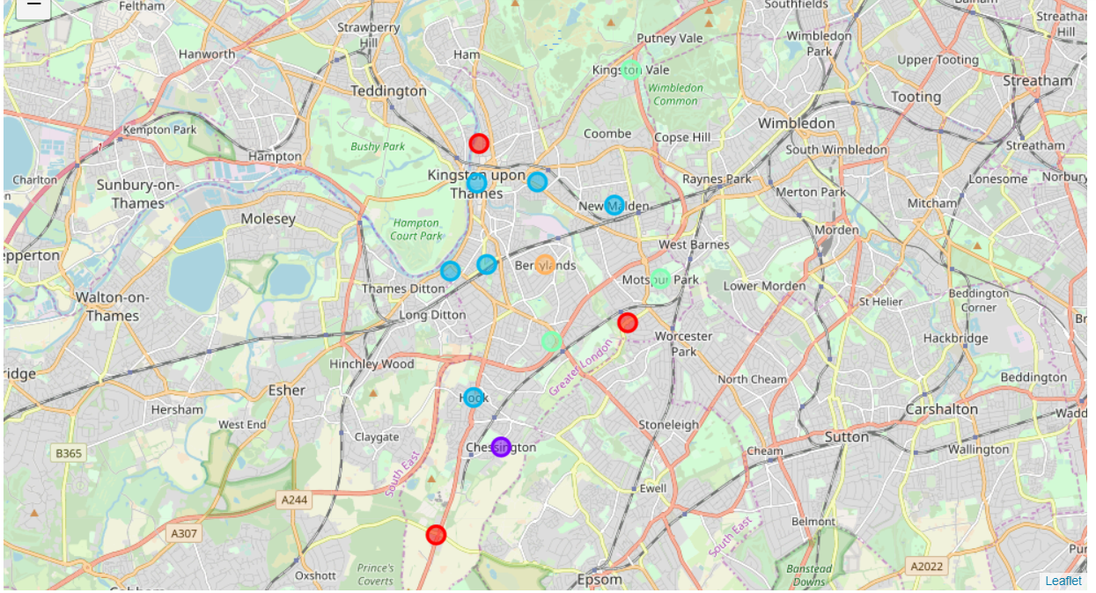
Results
We can access each cluster after running the K-means clustering. This is done to see which neighbourhoods were assigned to each of the 5 clusters. The cluster visualization was obtained using the folium library.

Slide 12
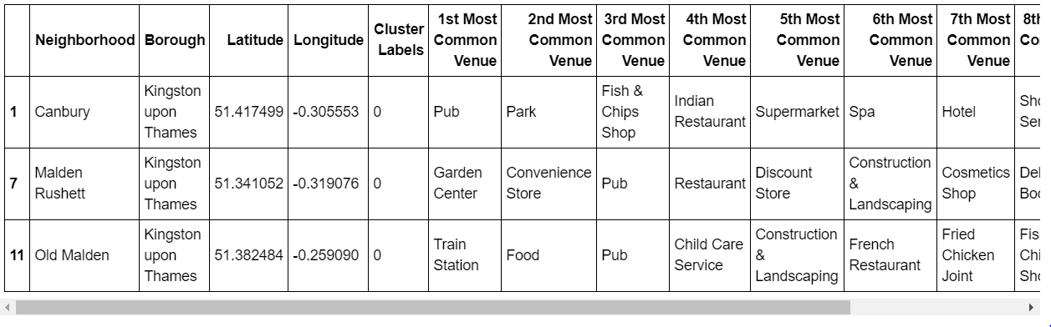
Clusters
Cluster 1: The cluster one is the second biggest cluster with 3 of the 15 neighbourhoods in the borough Kingston upon Thames. Upon closely examining these neighbourhoods we can see that the most common venues in these neighbourhoods are Restaurants, Pubs, Cafe, Supermarkets, and stores.

Slide 13
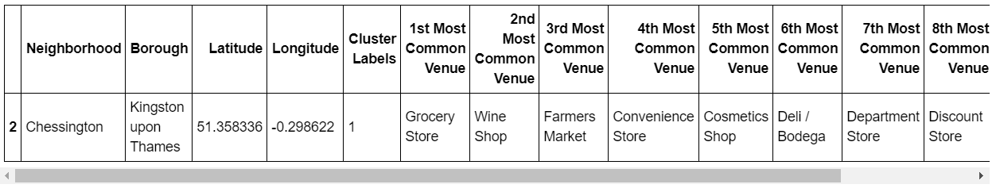
Cluster 2: The second cluster has one neighbourhood which consists of Venues such as store, wine shops and markets.

Slide 14
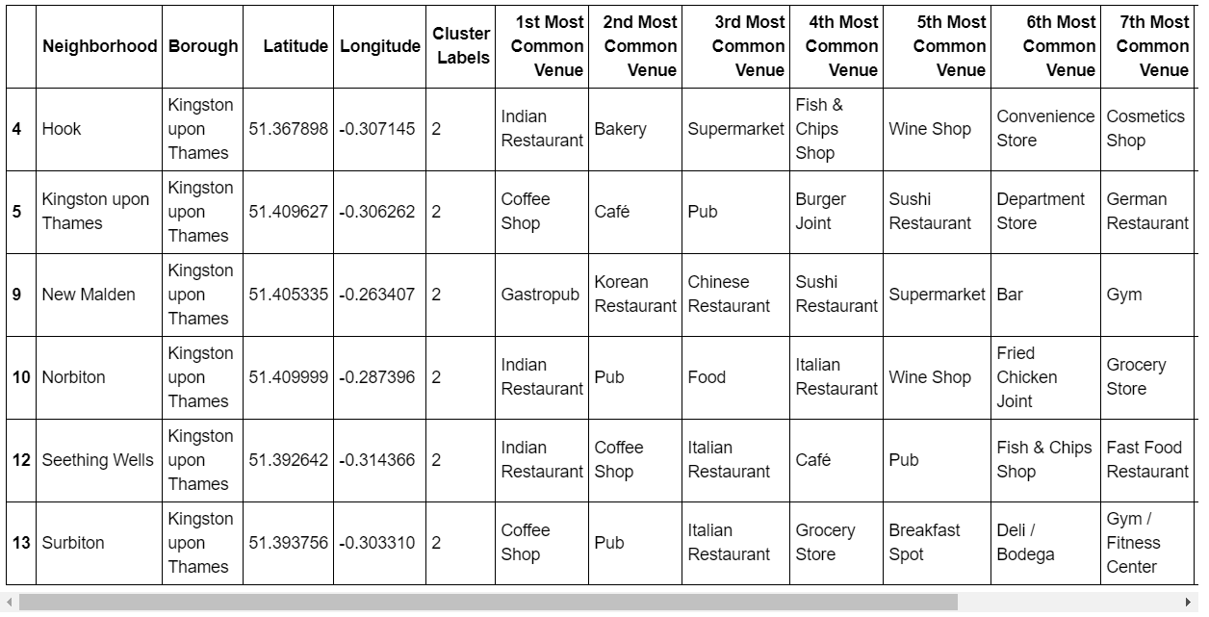
Cluster 3 : The third cluster has Six neighbourhoods, making it the largest cluster, it consists of Venues such as Pubs, Restaurants, Stores and Wine shops.

Slide 15
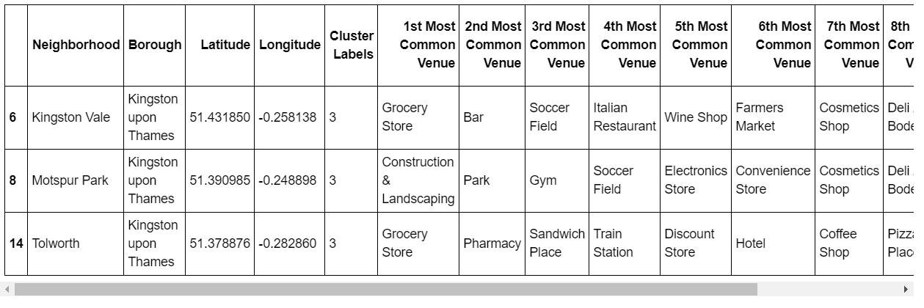
Cluster 4 : The fourth cluster has three neighbourhoods in it, these neighbourhoods have common venues such as Parks, Soccer fields, Train stations,Stores,etc.

Slide 16
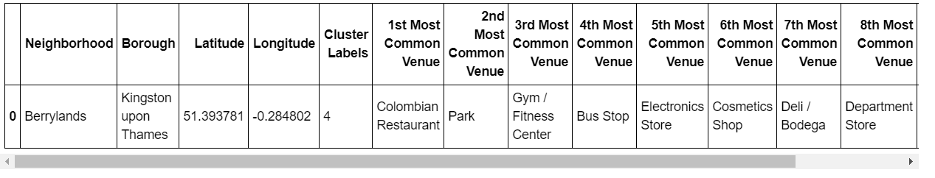
Cluster 5 : The fifth cluster has one neighbourhood which consists of Venues such as Park, Gym/Fitness Center,Electonic store,etc.

Slide 17
Discussion
The aim of this project is to help people who want to relocate to the safest borough in London, expats can choose the neighbourhoods to which they want to relocate based on the most common venues in it.
if a person is looking for a neighbourhood with good connectivity and public transportation we can see that Clusters 3 and 4 have Train stations and Bus stops as the most common venues. If a person is looking for a neighbourhood with stores and restaurants in a close proximity then the neighbourhoods in the first cluster is suitable.
For a family I feel that the neighbourhoods in Cluster 4 are more suitable dues to the common venues in that cluster, these neighbourhoods have common venues such as Parks, Gym/Fitness centers, Bus Stops, Restaurants, Electronics Stores and Soccer fields which is ideal for a family.

Slide 18
conclusion
This project helps a person get a better understanding of the neighbourhoods with respect to the most common venues in that neighbourhood.
The future of this project includes taking other factors such as cost of living in the areas into consideration to shortlist the borough based on safety and a predefined budget.

